Slide 1
Labview Final Project
學號:R09525082
系級:工海碩一
姓名:鄒萬新

Slide 2
Concept
Stat :1
Click :1
Start :1-4
Click :1-4
Start :1-4-3
Click :1-4-3
Start :1-4-3-4
Click :1-4-3-2
2
1
3
4
Break!!!

Slide 3
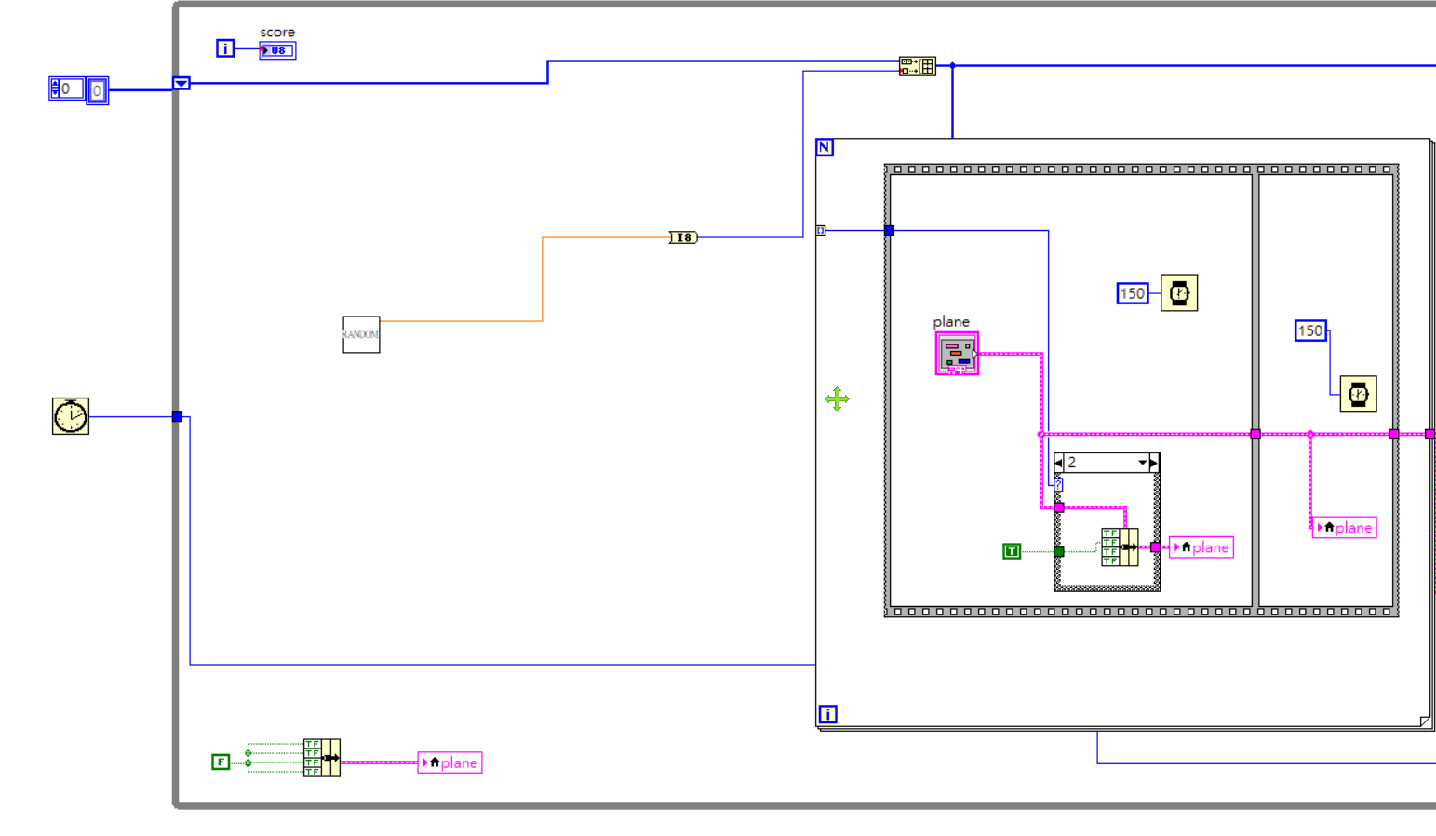
Program 2/1

Slide 4
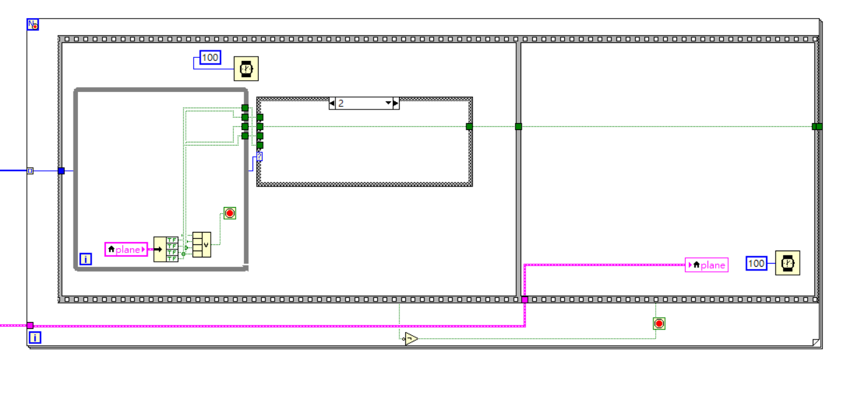
Program 2/2

Slide 5
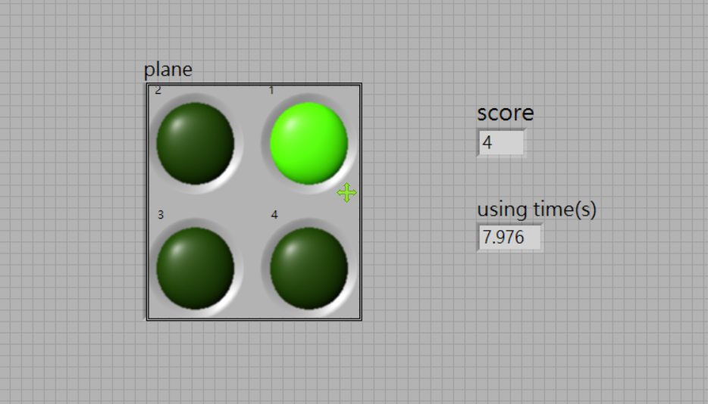
Actual program

